Slide 1
A Survey in Applications of Deep Learning in GIS – Spatiotemporal data mining and forecasting
A Thesis proposal & literature survey by
Supasin Wuthikulphakdi
ID# 608785068 Tamkang University

Slide 2
Introduction
Spatiotemporal data
a dataset collected in the space domain (a.k.a. a map over a location, heatmap, etc),
In a form of matrix
and the time domain (a.k.a. the time series).
In a form of tensor depth
Is a form of big data
Why we need to process ST-data?
Intelligent transport system (ITS)
automatic guidance, self-driving cars, traffic prediction, etc.
Weather & disaster forecast also need this form of data in the term of cloud/smog density
From overhead images
Problem: To manually collect, process, and forecast the ST data is a labourious task
Machine learning algorithms will do the job (i.e. SVM)
But ML architectures are not designed to extract feature representations autonomously
Deep learning algorithms are needed

Slide 3
Deep learning in ST-Data Mining
Artificial Neural Networks
capable of feature auto-extraction
CNN in space domain
RNN in time domain
CNN captures spatial features (i.e. heatmap, graph data (GCN), & data coordinates)
But not the time series (i.e. changes)
RNN-LSTM captures time features
But RNN has a problem of vanishing/exploding gradient
LSTM is preferred in later works
For the technical concepts
See the “proposal_sep10.docx” file for more details

Slide 4
Why am I doing this?
To explore how deep learning architectures and models can be used in ST-data mining
Especially in term of traffic flow prediction
Intelligent transport system (ITS)
Weather & disaster forecast
To discover what group of models, to date, is the best for STDM: analysis & prediction
In traffic flow prediction
ST-LSTM, LT-LSTM
More reasons to be given/advised to be written by the advisor

Slide 5
Forms of data in STDM
Event data
comprise of discrete events occurring at point locations and times
i.e. an event point recording coordinates and timestamp
Trajectory data
denote the paths traced by bodies moving in space over time
i.e. moving trail of a taxi trip
Point reference Data
consist of measurements of a continuous ST field
i.e. temperature record over a given space and time (ri, li, ti)
Raster data
Is actually pixelated PRD.
The record location is fixed within a pixel – so that a heatmap can be easily read

Slide 6
Neural Networks in STDM
Restricted Boltzmann Machine
two-layer stochastic neural network
dimensionality reduction, classification, feature learning and collaborative filtering
Supervised or Unsupervised
CNN
deep, feed-forward ANN
For spatial domain & static non-sequential data
GCNN
A CNN modified for graph analysis
RNN & LSTM
An ANN where connections between nodes form a directed graph along a sequence
For sequential analysis
Time series, NLP, Temporal domain, etc.
LSTM
Input gate, forget gate & output gate
Seq2seq & Autoencoders
Encoder NN + Decoder NN
Usually, unsupervised
Attention Mechanism
developed to improve the performance of the Encoder-Decoder RNN on machine translation
Allows an Encoder-Decoder RNN to pay attention to a long sequence

Slide 7
Literature review (to be updated)
Doshi et al. 2018 [1, 2], designed and used a CNN to identify disaster-impacted areas by comparing the change in man-made features extracted from satellite imagery.
Amit et al. 2017 [3], also used a custom CNN to detect kinds of disasters in overhead images.
Iglovikov et al. 2017 [4], used an FC-CNN named U-NET, along with an embedded multispectral sensor, which detects frequency reflection by the objects, to detect geo-features in satellite images and yielded satisfying results.
Bochkovskiy et al. [5] improved a CNN’s performance by integrating with YOLO v4
In Terms of video and sequence type photos, we need an LSTM-RNN
Fang et al. [6] used an LSTM to predict flood in Shangyou County, Jiangxi Province, China.

Slide 8
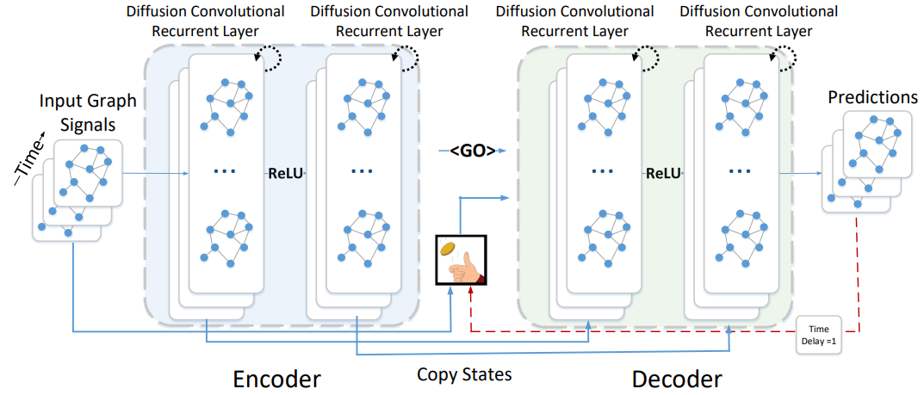
Literature Reviews
Li et al, 2018. [7], spatiotemporal forecasting
is a crucial task for a learning system that operates in a dynamic environment.
Useful in ITS & Smart cities
Diffusion Convolutional Recurrent Neural Network (DCRNN) model
Forecast the road traffic within a specific space and timeframe (The dataset was METR-LA, 2014). Diffusion convolution extracts the traffic features, and the RNN processes the traffic volumes in sequence.
Wang et al, 2019. [8]
surveyed and collected several papers about spatiotemporal data mining.
And explained the fundamentals and the concepts of STDM.

Slide 9
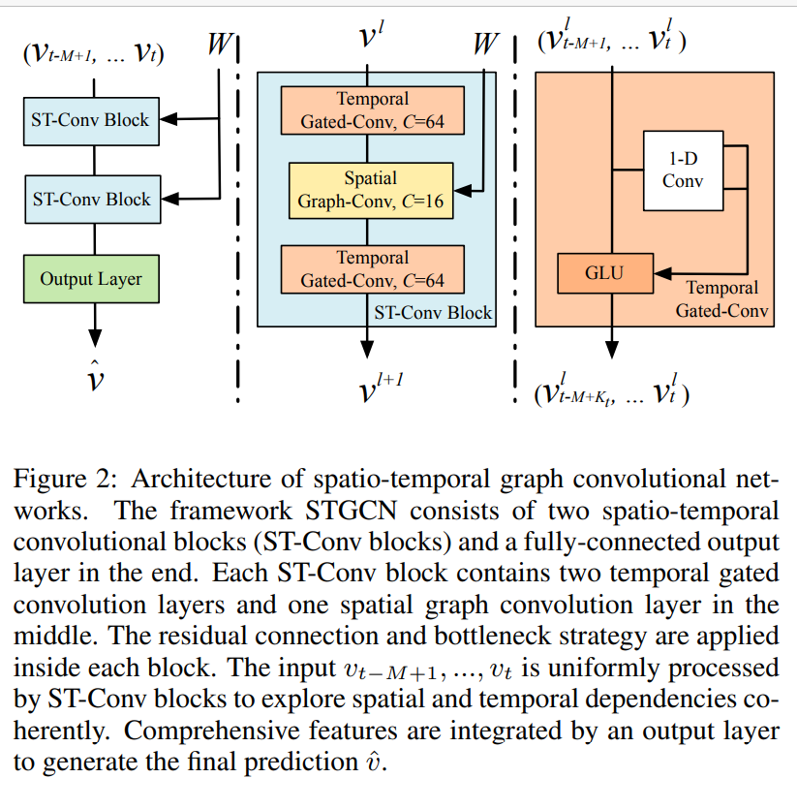
Literature Reviews
Yu et al, 2018. [9] proposed a Spatiotemporal Graph Convolutional Networks (STGCN)
to tackle the time series prediction problem in traffic domain.
They formulated the problem on graphs and build the model with complete convolutional structures
enabling much faster training speed with fewer parameters.

Slide 10
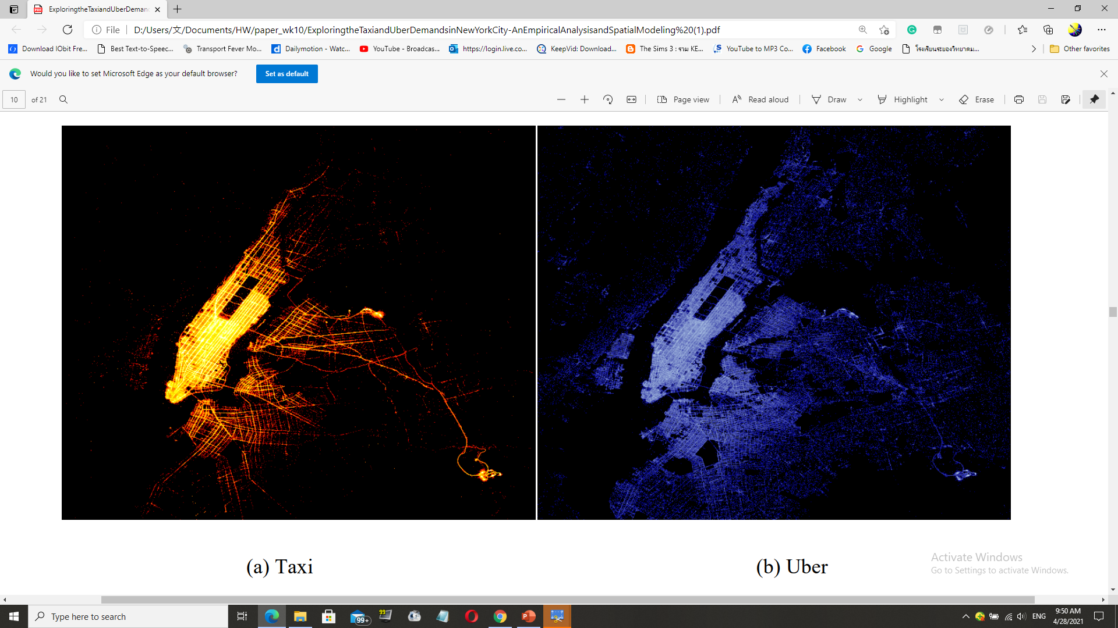
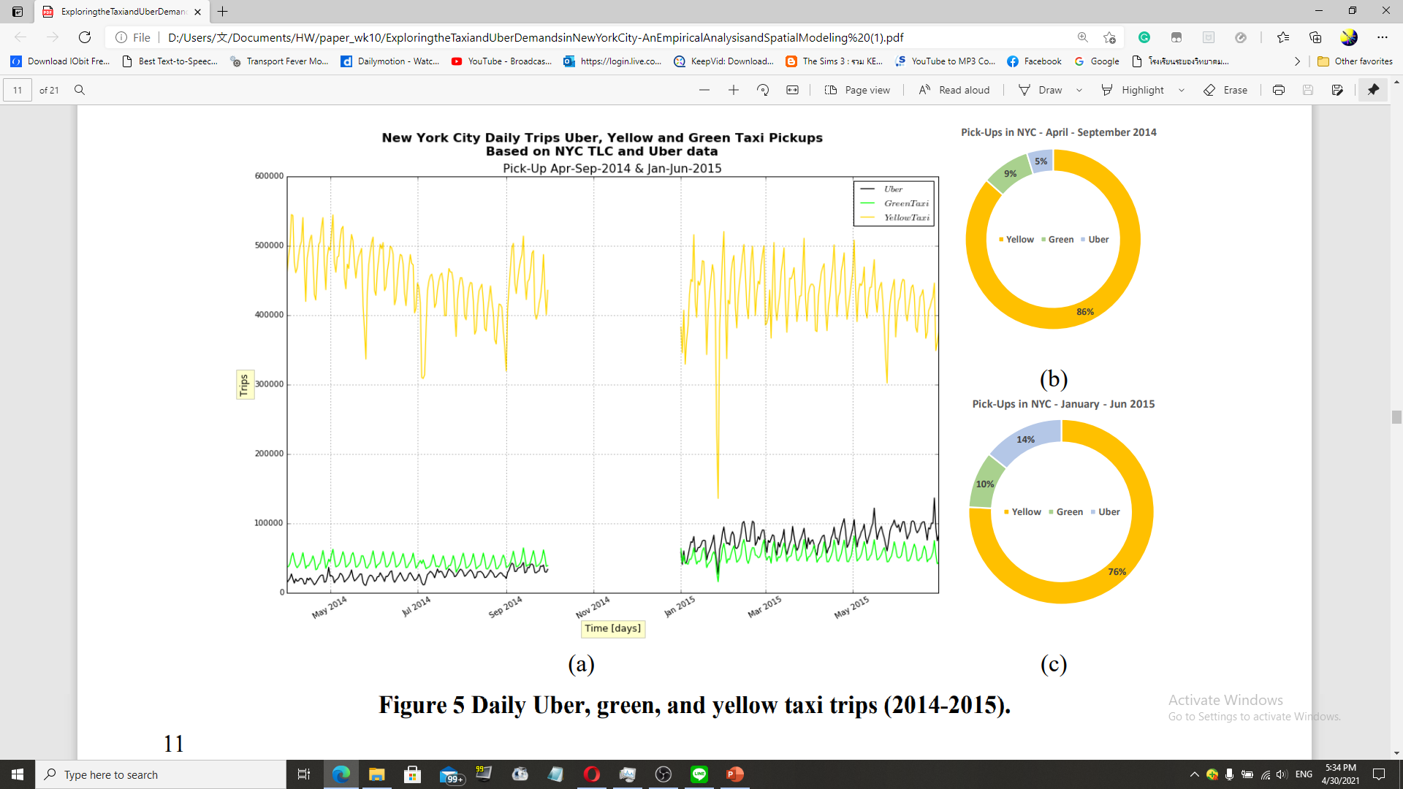
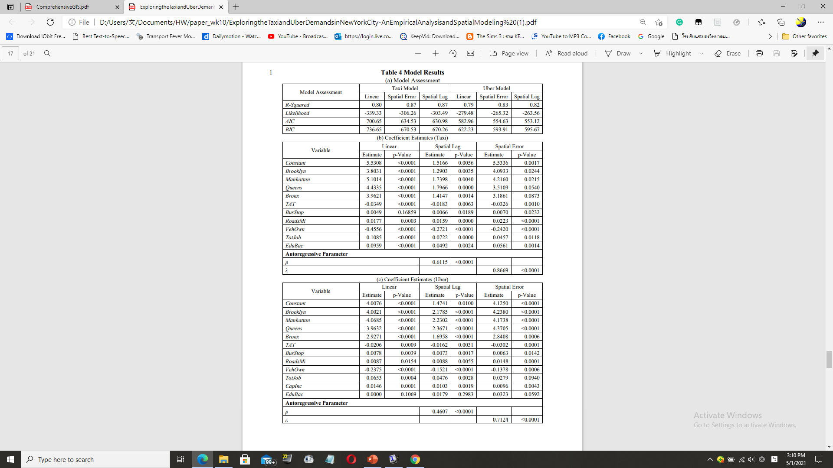
Literature Reviews
Correa et al, 2017 [3] performed a spatiotemporal data mining of Taxi vs Uber ridership in NYC, 2014+15.
According to the heatmap inside the paper, the ridership for both taxi systems depended on several factors
such as personal income, education, jobs, car ownership etc.
With 3 spatial models for ridership prediction – linear, spatial error and spatial lag models
the last one outperformed not only the first 2 algorithms, but also yielded a considerable accuracy and performance.
In the experiment, the presenter himself designed a Keras LSTM model

Slide 11
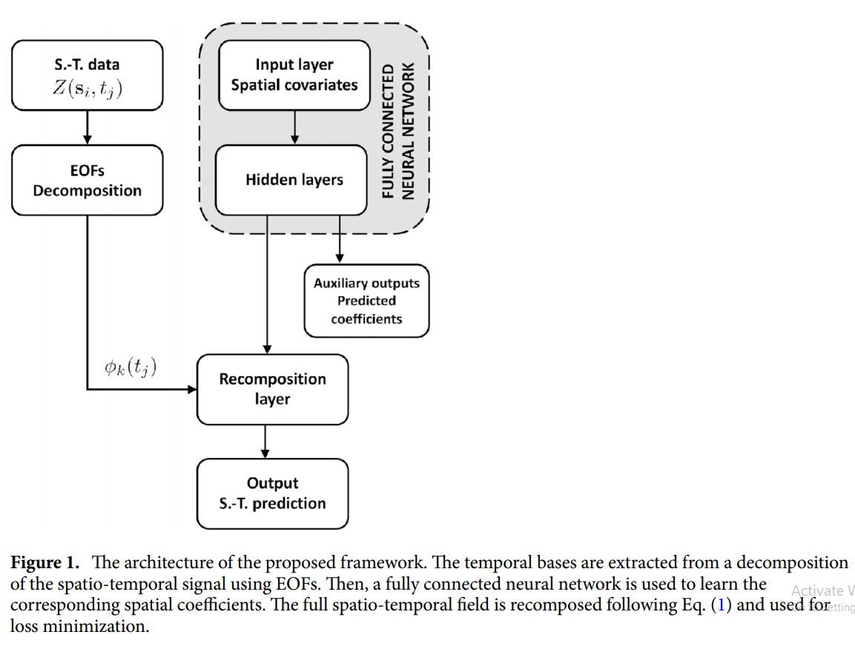
Literature Reviews
Amato et al. [11] designed a deep learning-based architecture called “Empirical Orthogonal Functions principal component analysis” EOF-PCA
in which the EOF framework decomposes the spatiotemporal input data
Then, the input layer spatial covariates are processed by a “Fully Connected Neural Network” (FCNN)
to obtain predictive coefficient to be recomposed altogether with the decomposed data stream, obtaining a spatiotemporal signal reconstruction.

Slide 12
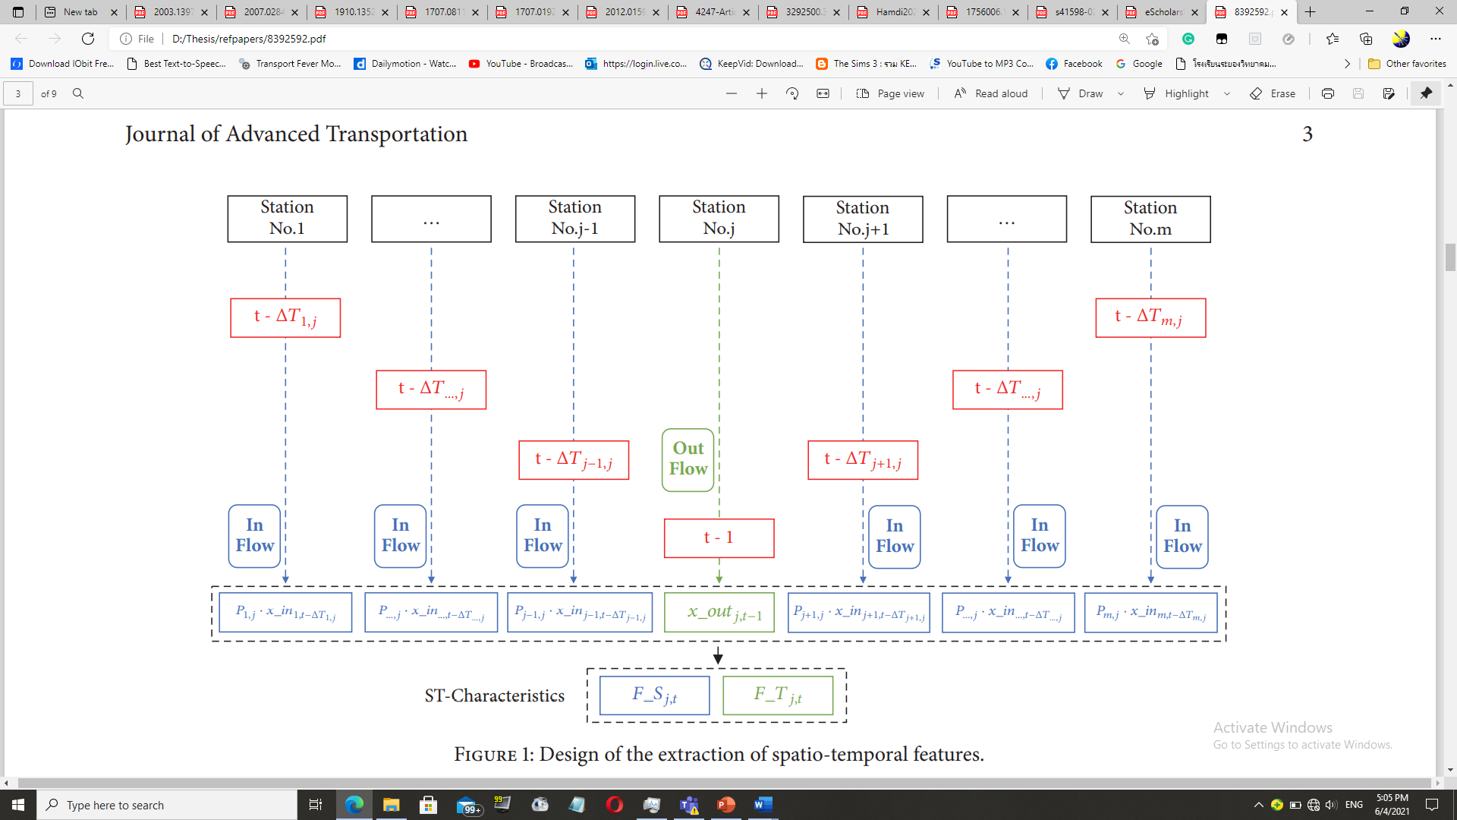
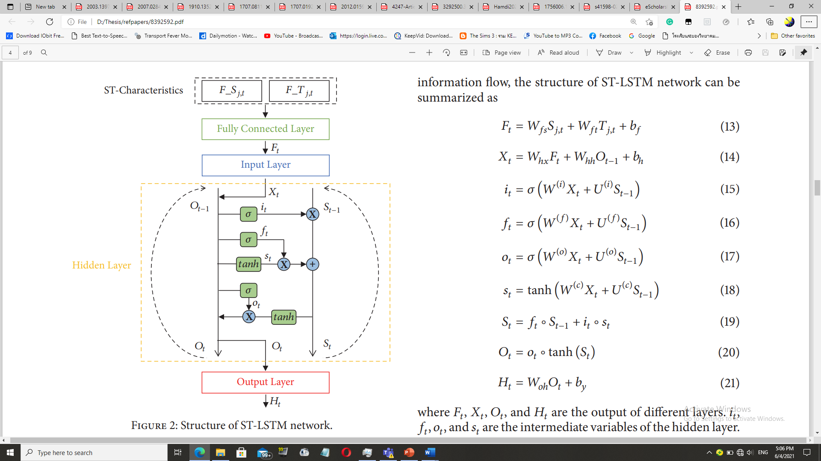
Literature Reviews
Tang et al. [12] designed an LSTM based framework to learn and forecast the rail traffic.
Accurate forecast can forewarn travel outburst, helping the passengers with their travel plans.
Even though the LSTM is notably effective in temporal data,
it cannot correlate the time domain with the space domain.
That is why they proposed ST-LSTM.
Compared with other conventional models, ST-LSTM network can achieve a better performance in experiments.

Slide 13
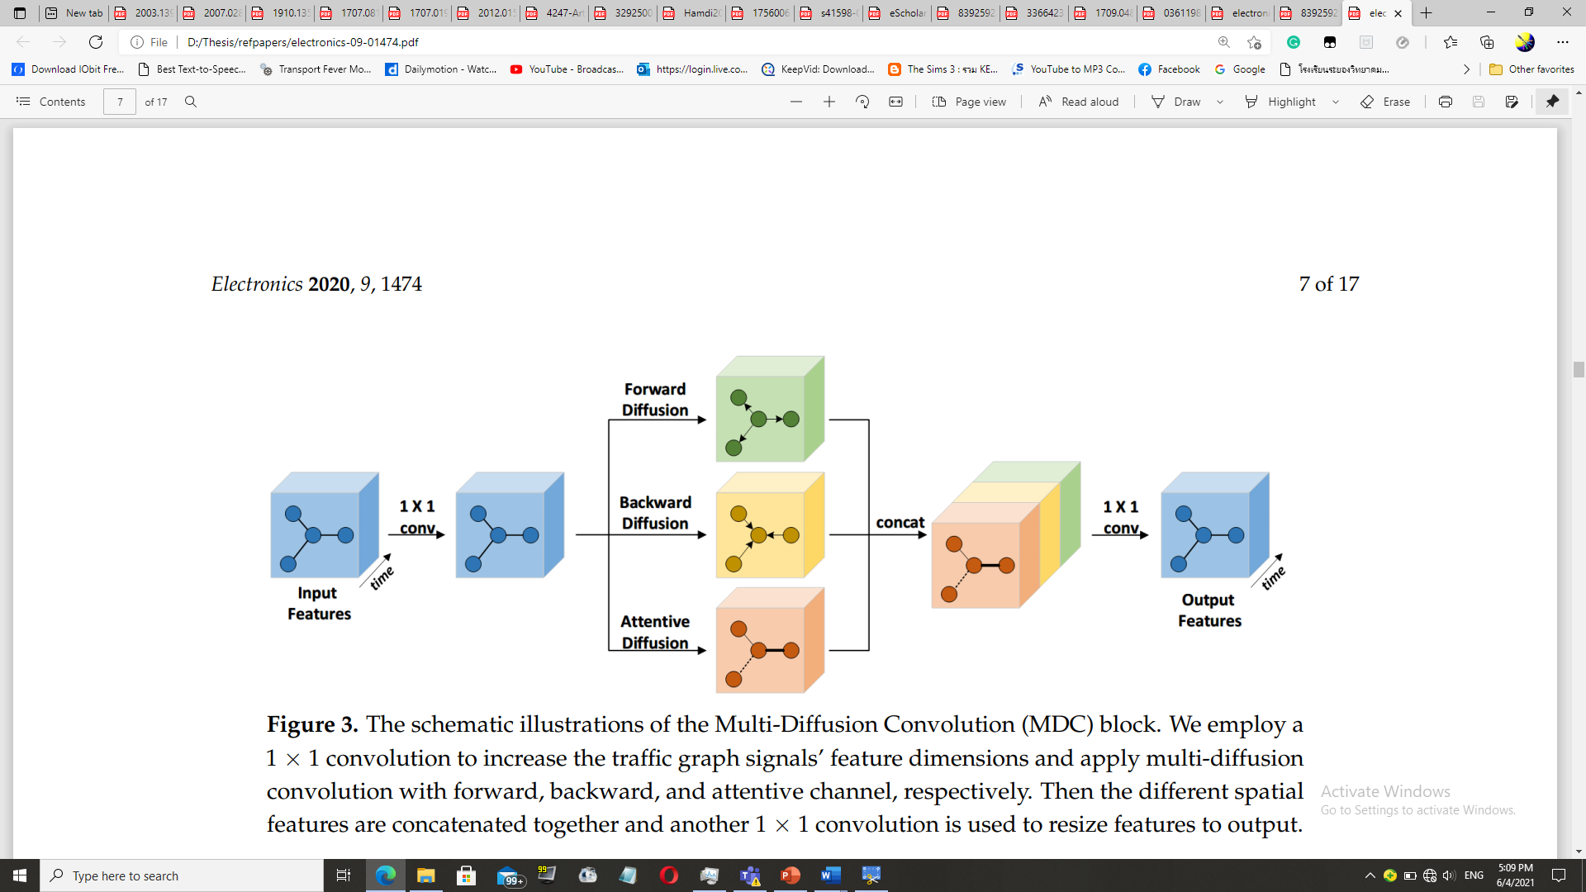
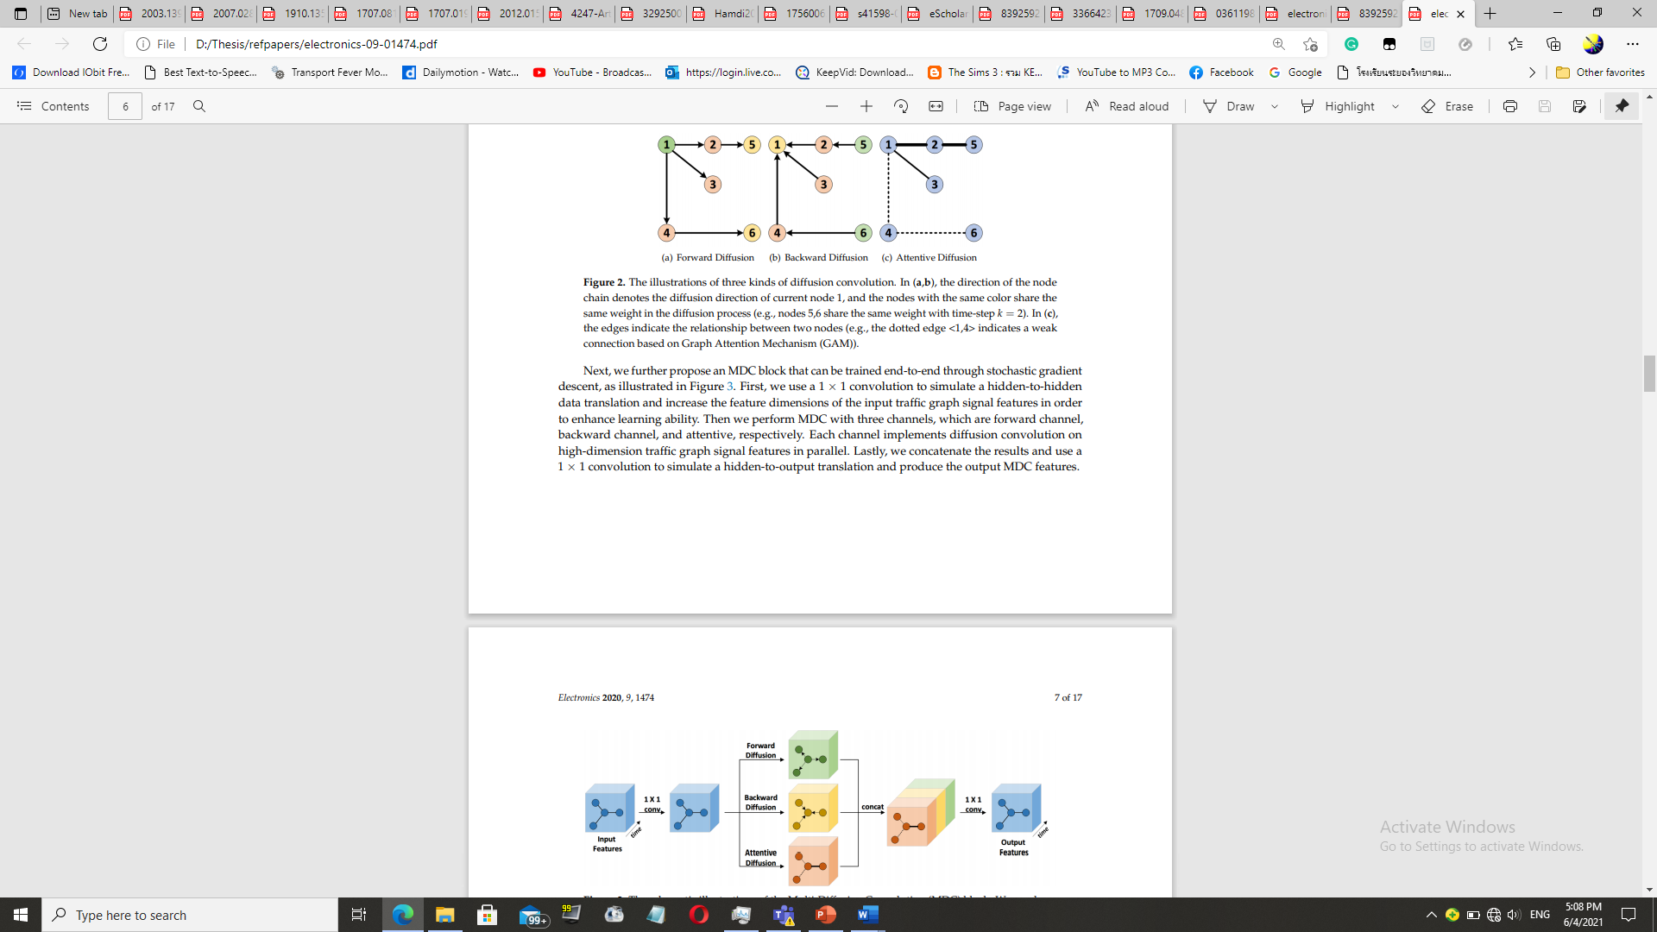
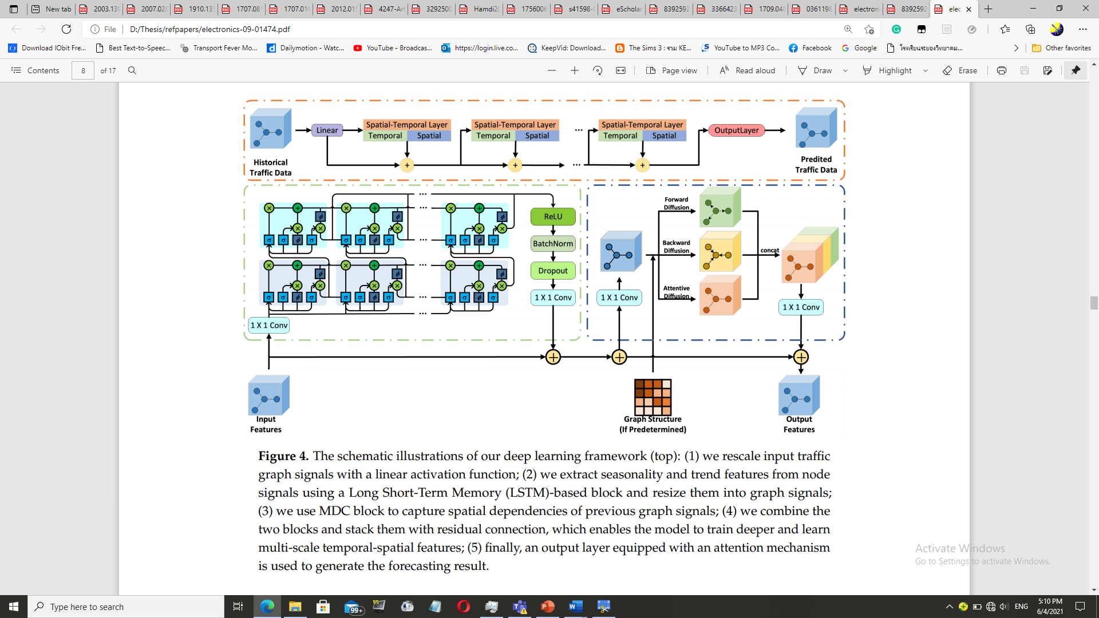
Literature Reviews
Lu et al. [13], designed a spatial-temporal deep learning network, termed ST-TrafficNet,
for traffic flow forecasting, whose architecture works as follows.
1. The Spatial Aware Multi-Diffusion Convolution Bloc (ADC-Block – who introduces Graph Attention Mechanism (GAM) into the MDC) uncovers unseen spatial dependencies from traffic graph signals automatically
2. From the data stream, the multi-diffusion convolution (MDC) block harvests ST-features of the spatial domain.
3. The ST-TrafficNet, an LSTM based framework, harvests the features of the temporal domain.
4. The output from both ANN are summed up to achieve convolutional results.
And 5. The ST-TrafficNet is evaluated on two benchmark datasets and compare it with various baseline methods for traffic forecasting.

Slide 14
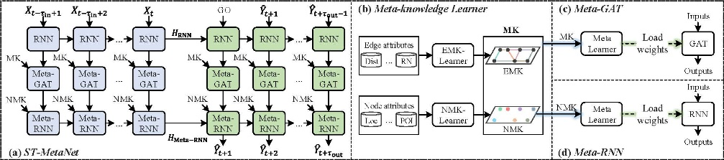
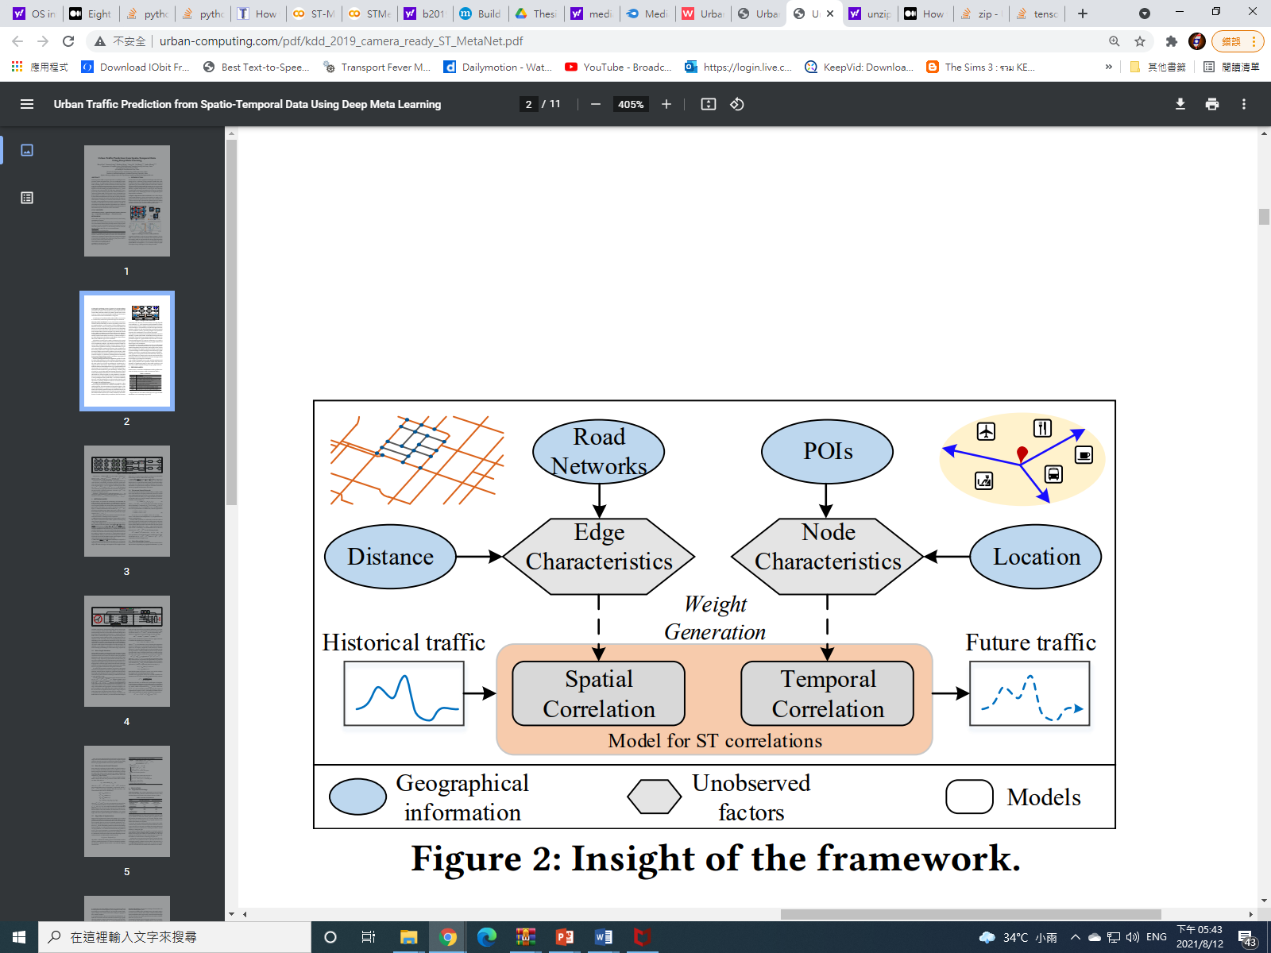
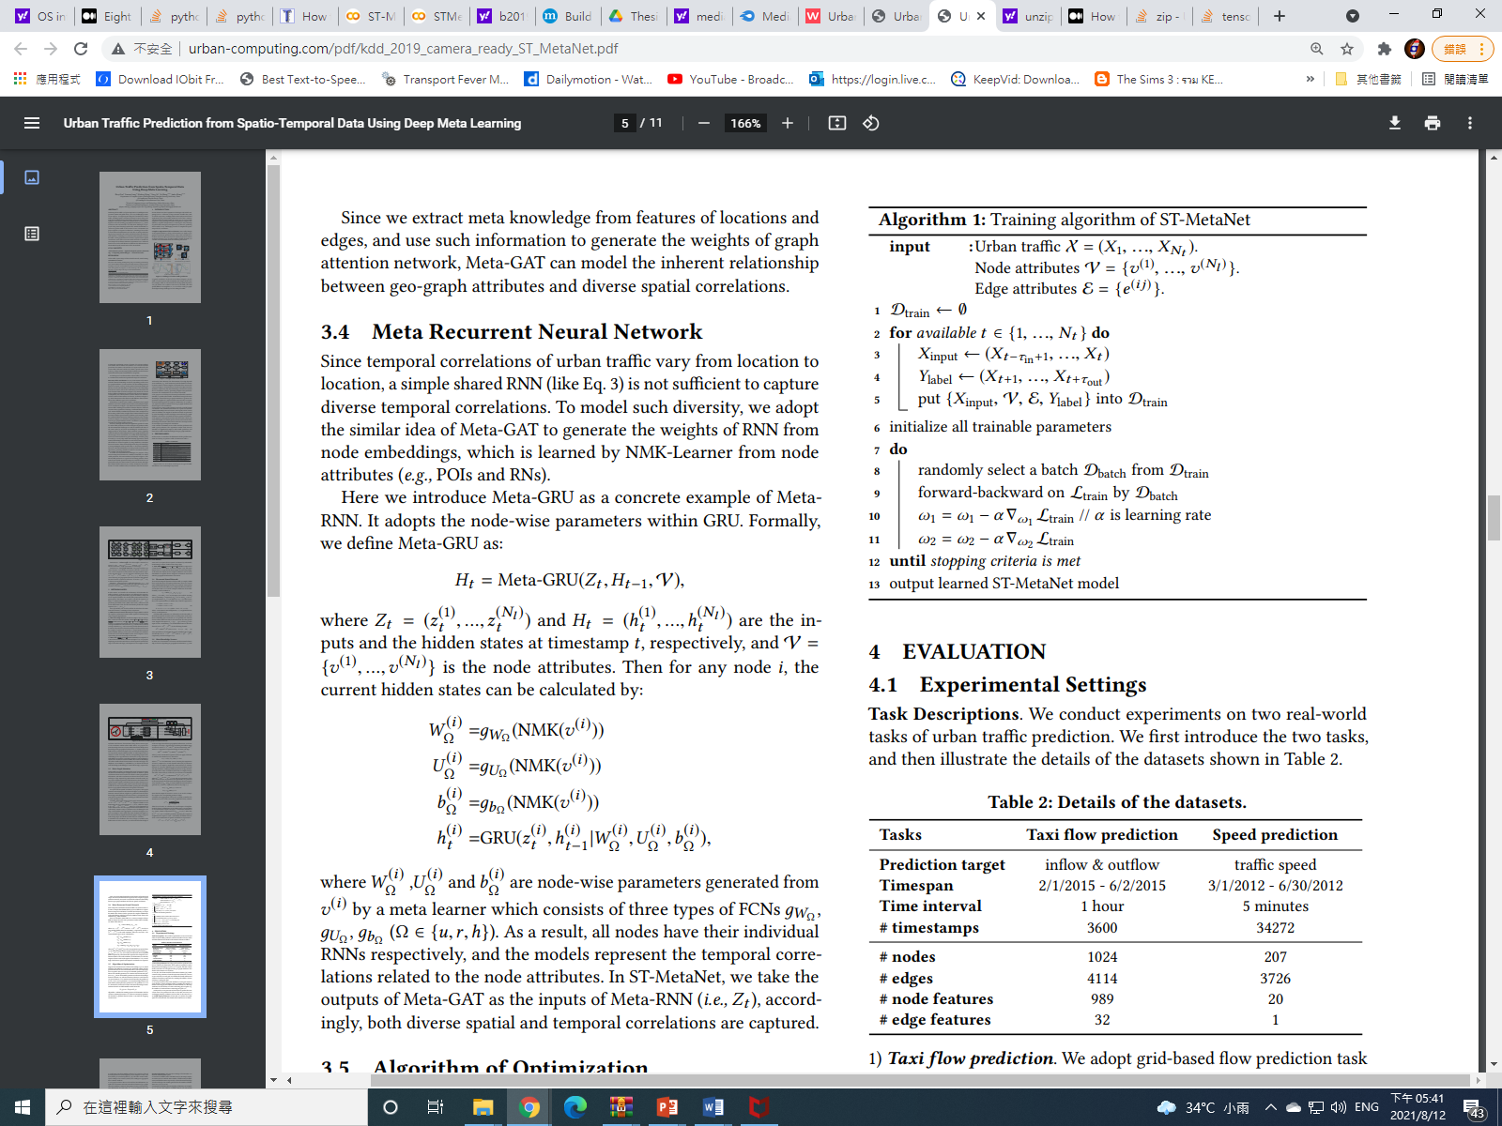
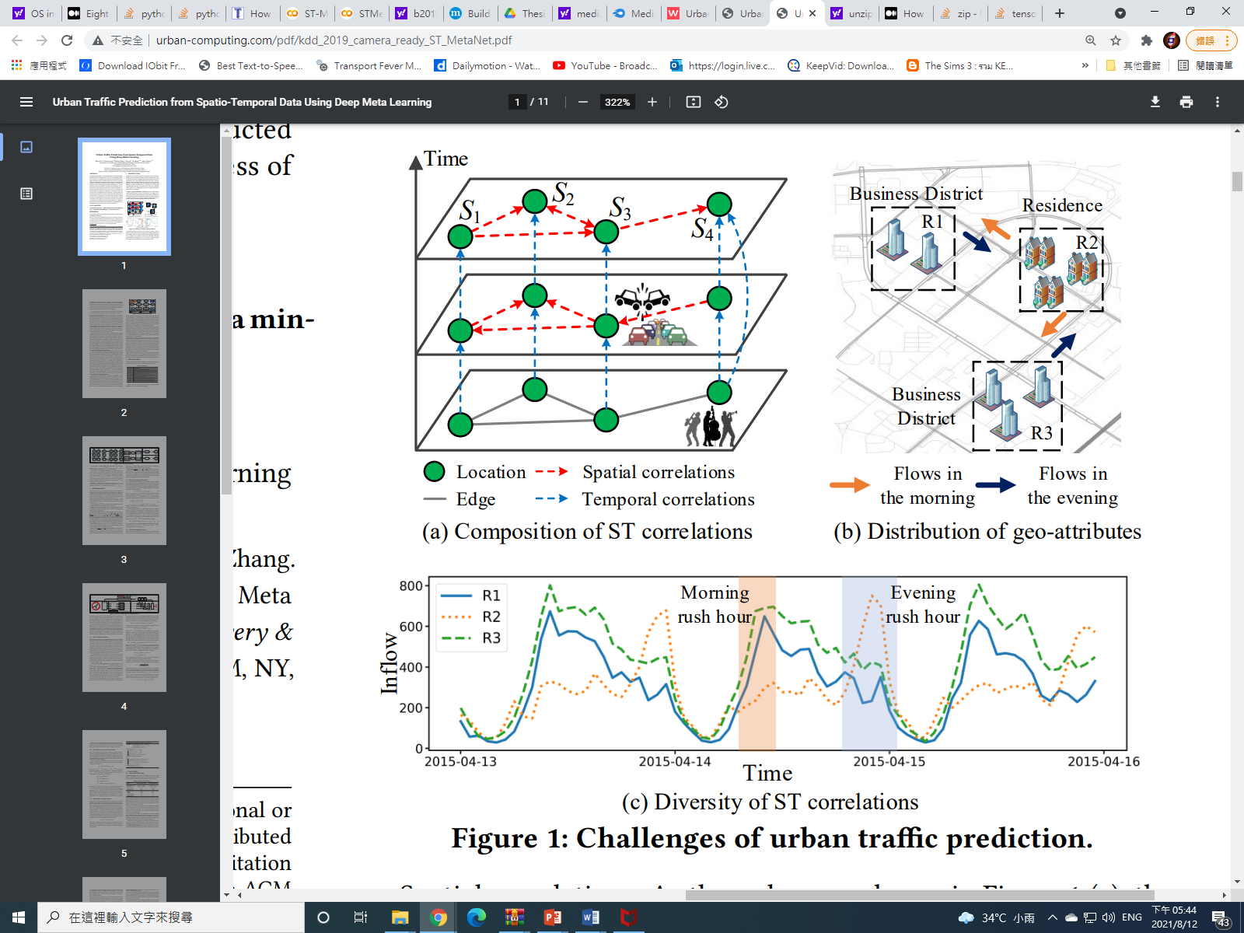
Pan et al. [14] designed a deep learning framework for traffic flow prediction called “ST-Metanet”
challenges: ST-correl. Of urban traffic. 2. diversity of such corr.
Model features & abilities:
Predict the traffic of all locations at once.
Seq2seq architecture
Encoder = learns historical data
RNN learns the urban traffic history
Meta-GATn
Meta-learner = FCN
Captures div. spatial corr.
Meta –RNN
Considers div. temp. corr.
Decoder = predicts the traffic step by step
Same structure as the encoder

Slide 15
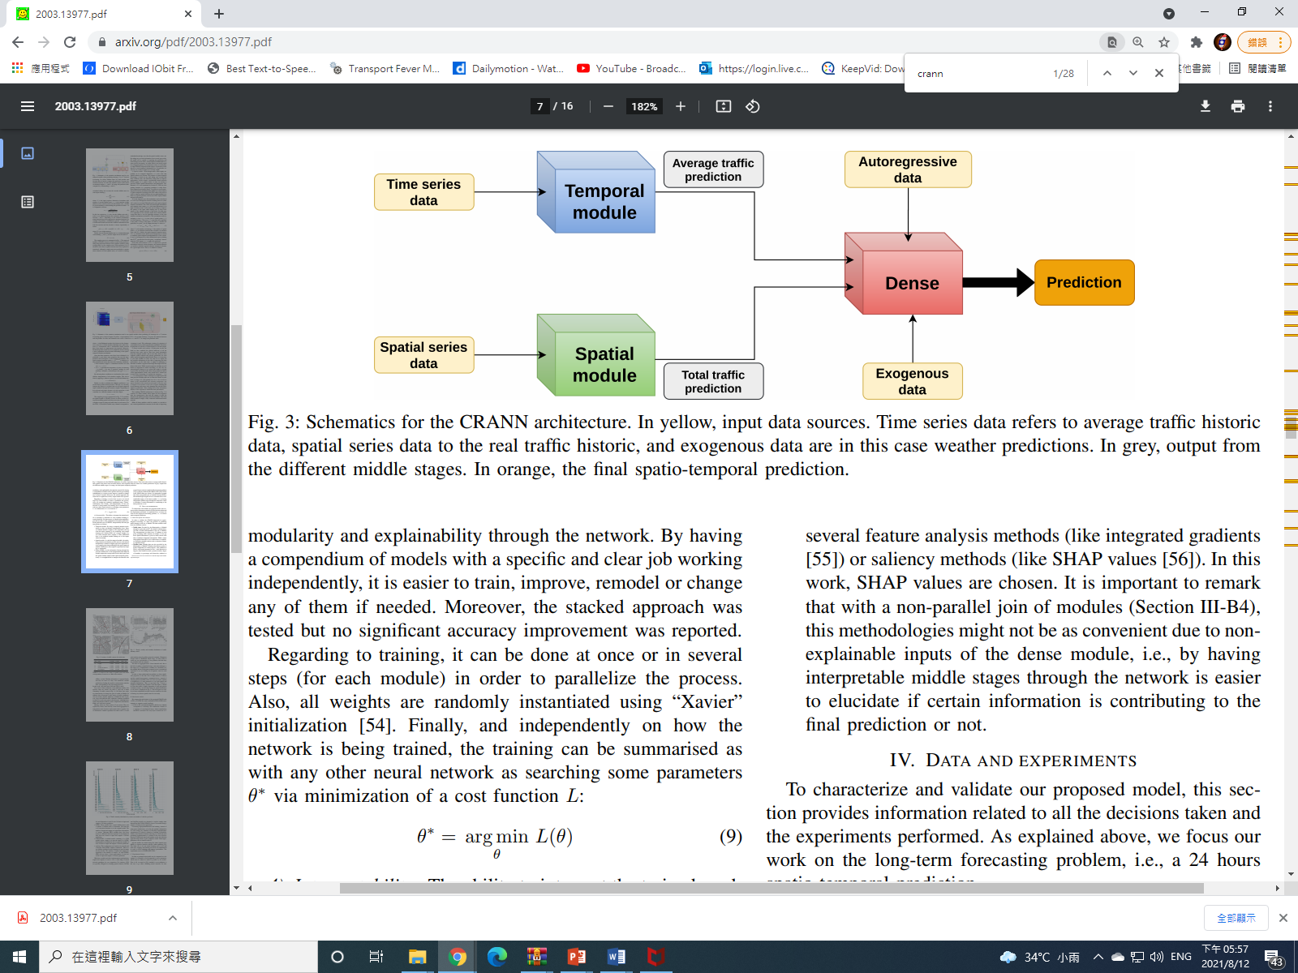
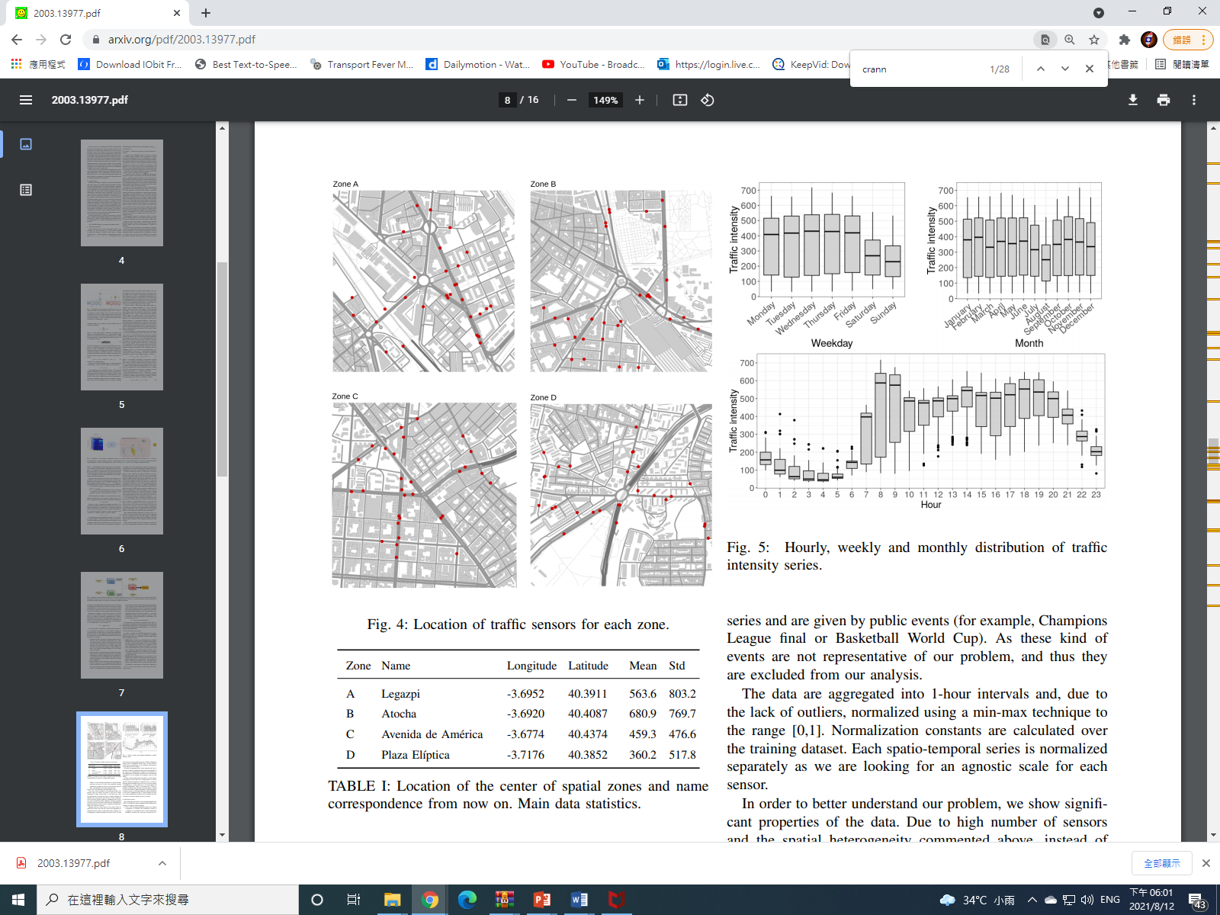
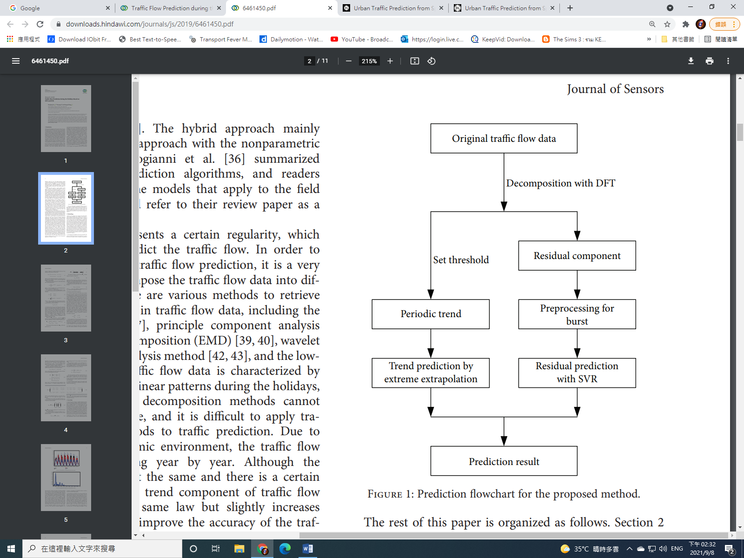
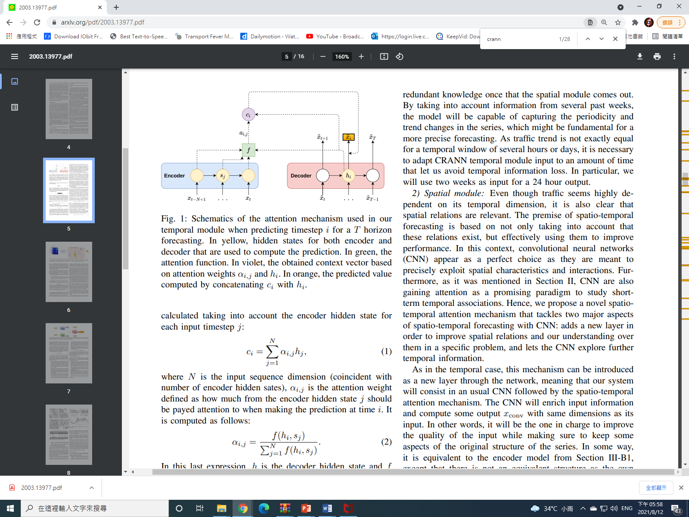
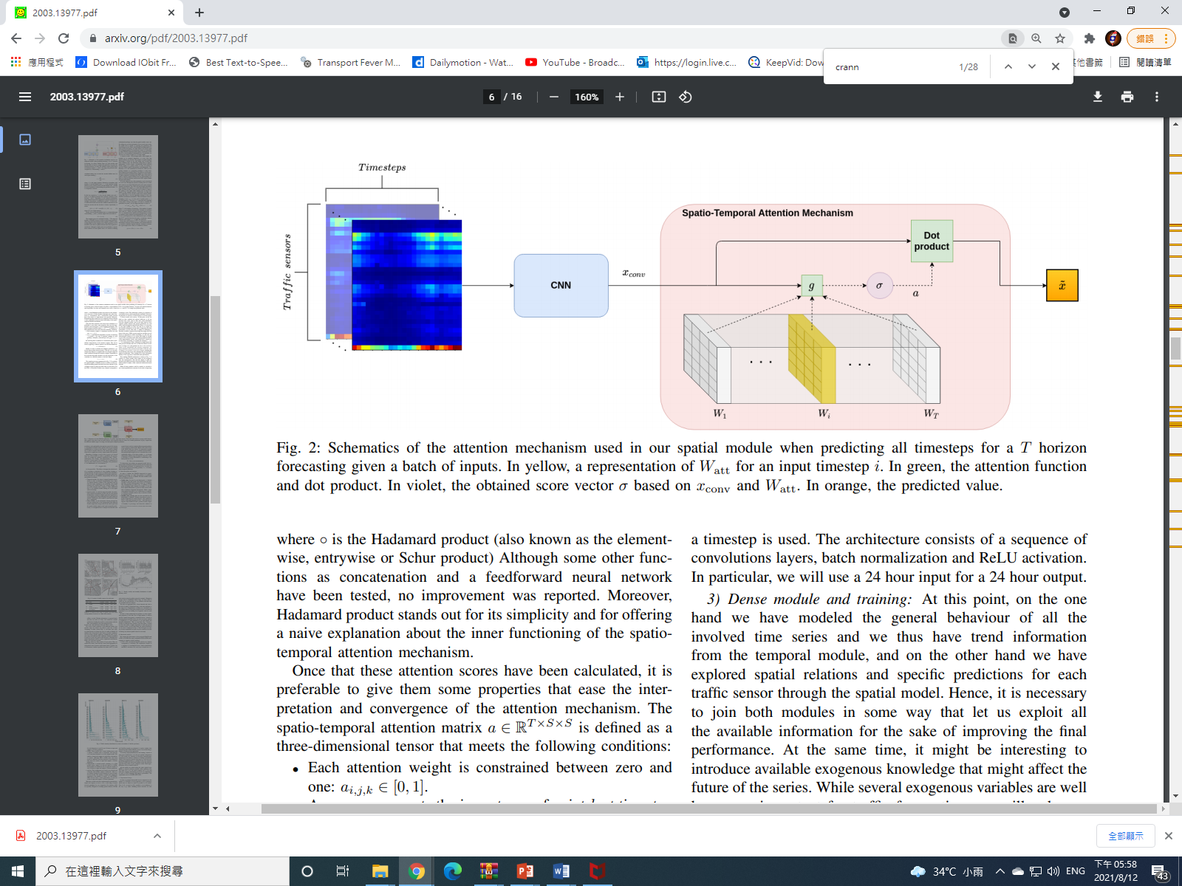
de Medrano et al [15] designed a CRANN deep neural framework for ST-traffic prediction
Convo-Recurrent Attentional Neural Network
Pros
Highly adaptable in several ST conditions
Easy to understand and interpret
stable and better than state-of-the-art alternatives
Based on an attention based NN
Several modules are combined
To capture key ST time series components

Slide 16
Luo et al, 2019 [16]
designed a discrete Fourier transform (DFT) and support vector regression (SVR) ML-architecture
to predict the road traffic flow during the holidays (2011-15) in Jiangsu Province, China
And outperformed several ML models
The model is described in the paper itself [16].

Slide 17
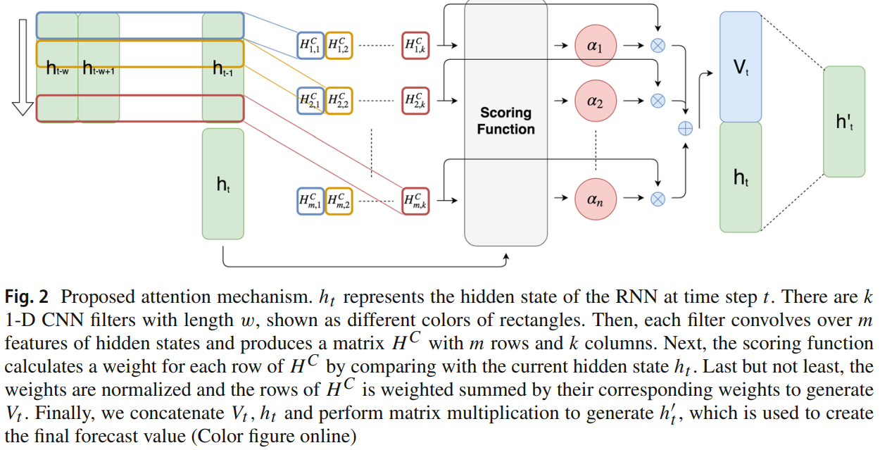
Shih et al. [18]
designed a multivariate LSTM architecture
“Temporal Pattern Attention LTSM” (TPA-LSTM)
to process complex and non-linear interdependencies
between time steps of multivariate time series data
The model uses a set of filters to extract time-invariant temporal patterns
TSD -> frequency domain
ATTM selects relevant time series
And forecast MVD using its FD

Slide 18
Methodology
This is a survey thesis
we will not design a custom model
From each referred/surveyed paper
we will run the Python code written for each model and dataset.
on GoogleTM-Colab environment
Then, we will run the models in the reference
With their own datasets
And compare their performance in the form of MSE & RMSE metrics
the less of them for each model, the better it performs in the term of learning and forecasting.
Finally, we will conclude which model does the best learning/forecast.
The Deep Learning models and ANNs
are written in Python with Pytorch & TensorFlow as our preferred modules.

Slide 19
Experiment settings
Architecture | Architecture Description | Dataset Description | Optimiser | Loss Function | learning rate | Epochs
Taxi-Simple-LSTM-pytorch | Simple-LSTM | Time series of Taxi-Uber DS. (2014-15) | Adam | MSE | 0.01 | 200
Uber-Simple-LSTM-pytorch | Simple-LSTM | Time series of Taxi-Uber DS. (2014-15) | Adam | MSE | 0.01 | 200
Taxi-Simple-LSTM-Keras | Simple-LSTM | Time series of Taxi-Uber DS. (2014-16) | Adam | MSE | 0.01 | 200
Uber-Simple-LSTM-Keras | Simple-LSTM | Time series of Taxi-Uber DS. (2014-17) | Adam | MSE | 0.01 | 200
CRANN-Temporal | Bahdanau Att.Mech Autoencoder (LSTM based) | temporal time series of hourly/daily car traffic (in Madrid) | Adam | MSE | 0.01 | 200
CRANN-Spatial | CNN+ST-Att.Mech | incidence captured by 30 sensors + Timestamps (A 17000x30 matrix) | Adam | MSE | 0.01 | 200
CRANN-Dense | Fully Connected Feedforward NN (FCFFNN) | dense 3D+ tensor of the both preceeding modules | Adam | MSE | 0.01 | 200
ST-Metanet | Improved Seq2eq | Traffic flow & speed dataset | Adam | MSE | 0.01 | 200
TPA-LTSM | Improved attentive lstm | muse dataset | Adam | tf.reduce.mean | 1E-05 | 40
Lotto-Seq2seq | Bahdanau Attentive LSTM | UK lotto dataset (2016-2020) | Adam | sparse_categorical_crossentropy | 0.0001 | 200

Slide 20
Experiment results
Architecture |  | Key Metrics |  | Other Metrics
 | MSE (either) | RMSE(train) | RMSE(test) | Type | Value
Taxi-Simple-LSTM-pytorch | 75534780 | 8691.075 | N/A
Uber-Simple-LSTM-pytorch | 0.03257497 | 0.1804854 | N/A
Taxi-Simple-LSTM-Keras | 17995921.47 | 4242.16 | 10723.58
Uber-Simple-LSTM-Keras | 33913501.66 | 5823.53 | 10244.89
CRANN-Temporal | 6954.61768 | - | 83.39435 | Rel.Err.% | 9.2181
CRANN-Spatial | 58546.6992 | - | 241.96425 | Rel.Err.% | 21.7391
CRANN-Dense | 67154.6172 | - | 259.14208 | Rel.Err.% | 24.7697
seq2seq(flow) | 1814.76 | 40.33592224 | 42.6 | MAE | 21.3
GAT-seq2seq(flow) | 1267.36 | 33.13670731 | 35.6 | MAE | 18.3
ST-Metanet(flow) | 1156 | 28.51646042 | 34 | MAE | 16.9
seq2seq(speed) | 52.8529 | 6.668972492 | 7.27 | MAE | 3.55
GAT-seq2seq(speed) | 44.3556 | 6.076465607 | 6.66 | MAE | 3.28
ST-Metanet(speed) | 39.0625 | 5.799274921 | 6.25 | MAE | 3.05
TPA-LSTM | RAE=0.3118 | RSE=0.4765 | CORR=0.9850 | Precision | 0.58851
 |  |  |  | Recall | 0.68889
 |  |  |  | F1 | 0.76333
Lotto-seq2seq | - | - | - | Sparse Top K | 0.22571

Slide 21
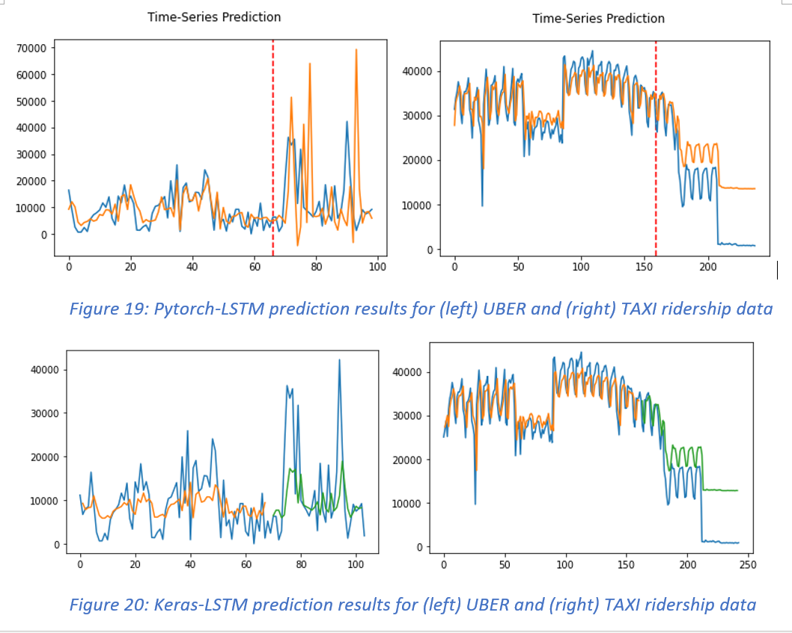
Experiment results
It is also apparent that complex state-of-the-art models (i.e. CRANN)
greatly outperformed simple models (i.e. Keras LSTM)
The table rows highlighted in yellow
Can run only on upgraded, paid COLAB.
require significant architectural changes to calculate the MSE
due to unequal input-output tensor dimensions
Seen from the last page’s table
the ST-Metanet model, to date,
is the best model for spatiotemporal traffic prediction
due to complexity of the model containing MKL, GAT and RNN.

Slide 22
Issues
The ST-Metanet model by Pan et al. [7] has a set of stringent environmental and modular requirements
Which must be 100% met, otherwise the model will not run.
Mxnet version worked 1.4.0
But the colab notebook crashed due to insufficient RAM (required at least 64GB)
Pymal has a ‘six’ dependency version conflict with pandas
A Cloud VM seems to be the most promising solution
Even the environment adjustment for CUDA on Colab cannot overcome the Mxnet error
CUDA 9.0, MXNET-cu90==1.5.0
Next Monday: Run the model with Mxnet=1.4.0
Or we will consider skipping this model, and continue our work on less stringent models
The TRA-LSTM model by Shih et al. [17], despite suitable environment set on COLAB, takes forever to train.
It is better to run it on a physical machine under Jupyter notebook, otherwise run it under COLAB PRO+ Environment.

Slide 23
Timeline
Project Phases:
October
Environmental Solutions, Further model runs, statistical collection & analysis of model performance
November
Result & Analysis + Writing a paper.
December
Finish the paper.
January
Defence oral exam

Slide 24
References
[1] Doshi, J., Basu, S. and Pang, G., 2018. From satellite imagery to disaster insights. arXiv preprint arXiv:1812.07033.
[2] Doshi, Jigar. 2018. Residual Inception Skip Network for Binary Segmentation. Pages 216–219 of:Proceedings of the IEEE Conference on Computer Vision and Pattern Recognition Workshops. [3] Amit, S.N.K.B. and Aoki, Y., 2017, September. Disaster detection from aerial imagery with convolutional neural network. In 2017 International Electronics Symposium on Knowledge Creation and Intelligent Computing (IES-KCIC) (pp. 239-245). IEEE.
[4] V. Iglovikov, S. Mushinskiy, and V. Osin, “Satellite Imagery Feature Detection using Deep Convolutional Neural Network: A Kaggle Competition,” vol. June, 2017.
[5] A. Bochkovskiy, C.-Y. Wang, and H.-Y. M. Liao, “Yolov4: Optimal speed and accuracy of object detection,” ArXiv, vol. abs/2004.10934, 2020.
[6] Fang, Z., Wang, Y., Peng, L. and Hong, H., 2020. Predicting flood susceptibility using LSTM neural networks. Journal of Hydrology, [online] p.125734. Available at: <https://doi.org/10.1016/j.jhydrol.2020.125734> [Accessed 18 April 2021].
[7] Li, Y., Yu, R., Shahabi, C., & Liu, Y. (2017). Diffusion convolutional recurrent neural network: Data-driven traffic forecasting. arXiv preprint arXiv:1707.01926.
[8] Wang, S., Cao, J., & Yu, P. (2020). Deep learning for spatio-temporal data mining: A survey. IEEE Transactions on Knowledge and Data Engineering.
[9] Yu, B., Yin, H., & Zhu, Z. (2017). Spatio-temporal graph convolutional networks: A deep learning framework for traffic forecasting. arXiv preprint arXiv:1709.04875.
[10] Correa, D., Xie, K., & Ozbay, K. (2017). Exploring the taxi and Uber demand in New York City: An empirical analysis and spatial modeling. In 96th Annual Meeting of the Transportation Research Board, Washington, DC.
[11] Amato, F., Guignard, F., Robert, S., & Kanevski, M. (2020). A novel framework for spatio‑temporal prediction of environmental data using deep learning. Scientific Reports, 2020(10), 22243. doi: 10.1038/s41598-020-79148-7
[12] Tang, Q., Yang, M., & Yang, Y. (2019). ST-LSTM: A Deep Learning Approach Combined Spatio-Temporal Features for Short-Term Forecast in Rail Transit. Journal of Advanced Transportation, 2019, Article ID 8392592. doi:https://doi.org/10.1155/2019/8392592
[13] Lu, H., Huang, D., Song, Y., Jiang, D., Zhou, T., & Qin, J. (2020). ST-TrafficNet: A Spatial-Temporal Deep Learning Network for Traffic Forecasting. Electronics, 2020(9), 1474.
[14] Pan, Z., Liang, Y., Wang, W., Yu, Y., Zheng, Y., & Zhang, J. (2019, July 25). Urban Traffic Prediction from Spatio-Temporal Data Using Deep Meta Learning. Proceedings of the 25th ACM SIGKDD International Conference on Knowledge Discovery & Data Mining. KDD ’19: The 25th ACM SIGKDD Conference on Knowledge Discovery and Data Mining. https://doi.org/10.1145/3292500.3330884
[15] de Medrano, R., & Aznarte, J. L. (2020). A spatio-temporal attention-based spot-forecasting framework for urban traffic prediction. Applied Soft Computing, 96, 106615.
[16] Luo, X., Li, D., & Zhang, S. (2019). Traffic flow prediction during the holidays based on DFT and SVR. Journal of Sensors, 2019.
[17] Jiawei Han, Micheline Kamber, Jian Pei, 13 - Data Mining Trends and Research Frontiers, Morgan Kaufmann, 2012, Pages 585-631.
[18] Shih, S. Y., Sun, F. K., & Lee, H. Y. (2019). Temporal pattern attention for multivariate time series forecasting. Machine Learning, 108(8), 1421-1441.

